Slide 1

Random Forests
Yassine Ben Slama
bensya01@thu.de

Slide 2
Presentation Outline
What is a Random Forest?
Evaluation
Optimizations
Parallelization
Conclusion

Slide 3
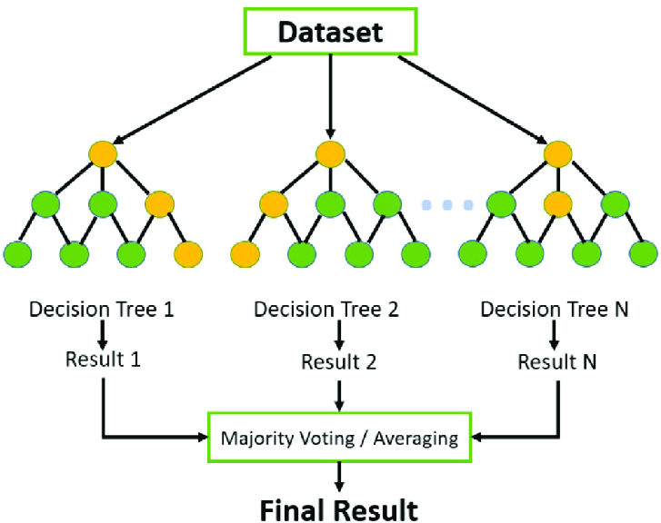
What is a Random Forest?
An Ensemble learning method based on decision trees.
It is used for both classification and regression.
https://www.researchgate.net/figure/An-example-of-Random-Forests_fig7_350928514
Value prediction
Predefined Classes

Slide 4
Where would you use it?
Used in medical field for optimizing prediction methods and models.
The same for bio-informatics fields.
Used also in banking, to predict the credibility of clients.

Slide 5
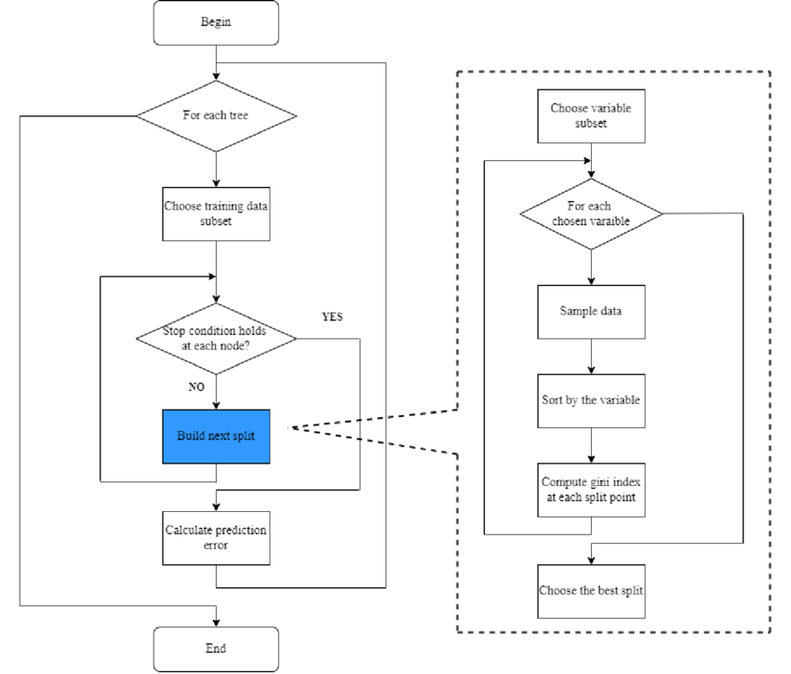
Flow Chart
This flow chart explains what happens throughout the algorithm.
https://www.researchgate.net/figure/Random-forest-flowchart_fig4_366073347

Slide 6
Bagging
Bagging stands for Bootstrap Aggregation.
Bootstrapping consists of the random choice of subsets for each tree.
Aggregation is the combination of the prediction of each tree.
Bootstrapping also returns an additional set called Out-Of-Bag set.
One of the ways of error prediction is the OOB error.
https://www.researchgate.net/figure/Random-forest-flowchart_fig4_366073347

Slide 7
Best Split
Splitting is done multiple times during the building of each tree.
The split is decided through a splitting criteria calculation for each feature variable.
Both Gini index and Entropy (information gain) can be used to as a splitting criteria.
https://www.researchgate.net/figure/Random-forest-flowchart_fig4_366073347

Slide 8
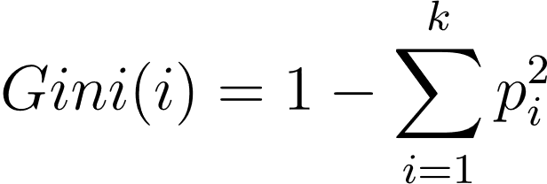
Gini index
Entropy
Formula:
Gini(left) here means the Gini impurity of the left child node, it is calculated this way
Formula:
Entropy(left) here means the information gain of the left child node, it is calculated this way:

Slide 9
Evaluation

Slide 10
Prediction Evaluation
Out-Of-Bag error
Confusion Matrix
Accuracy, Precision, Recall, F1 Score
K-fold cross validation
Receiver Operating Characteristic (ROC) Curve and Area Under the Curve (AUC)
https://www.researchgate.net/figure/Random-forest-flowchart_fig4_366073347

Slide 11
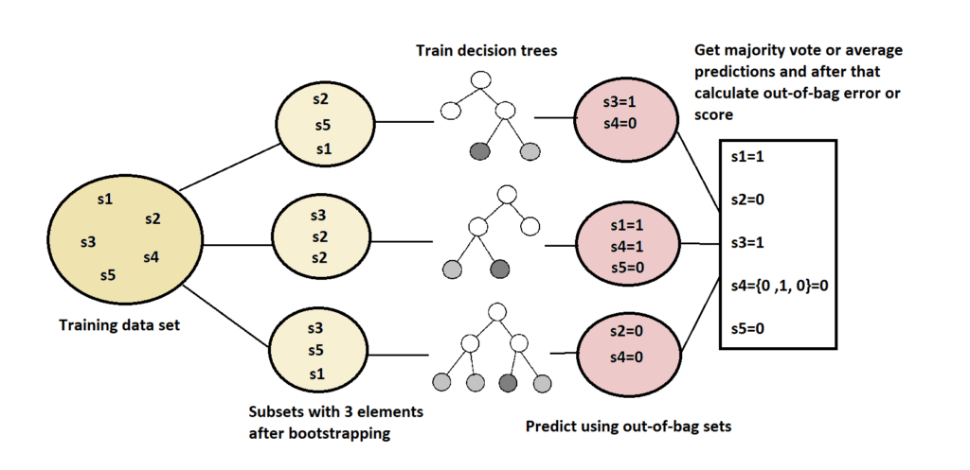
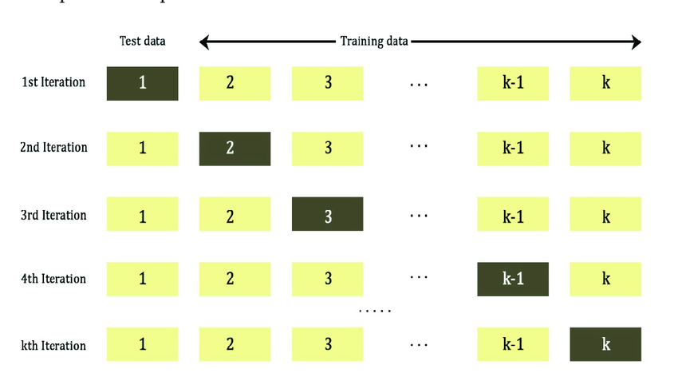
OOB-Error
K-fold CV
https://www.baeldung.com/cs/random-forests-out-of-bag-error
https://www.researchgate.net/figure/Schematic-of-k-fold-cross-validation_fig1_361891178

Slide 12
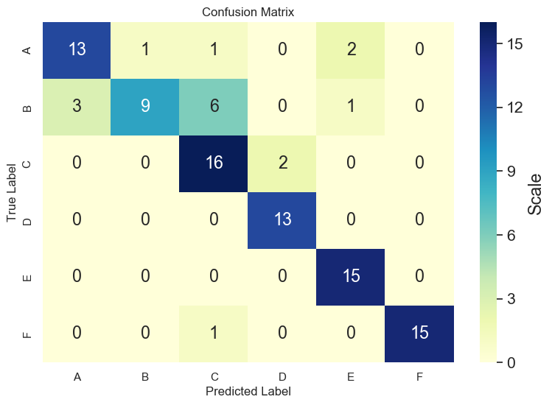
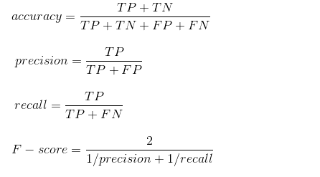
Accuracy, Precision, Recall, F1 Score
Confusion Matrix
Correctness of prediction
Rate of correct positive guesses
Rate of correct positive guesses out of positive instances
https://www.twblogs.net/a/5c8416bcbd9eee35fc13e15f
https://onestopdataanalysis.com/wp-content/uploads/2020/02/confusion_matrix.png

Slide 13
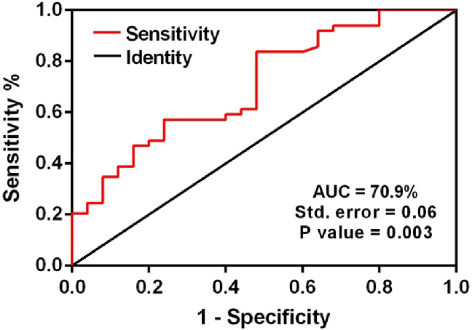
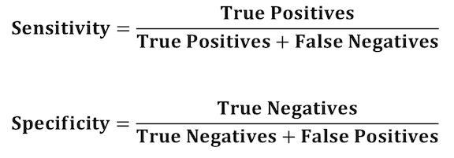
ROC Curve, AUC
https://miro.medium.com/v2/resize:fit:576/1*RWwHcEAgsd-yAs7UhRLuVg.png
https://www.researchgate.net/figure/area-under-curve-aUC-of-receiver-operating-characteristic-roC-analysis-for-let-7f_fig3_290263669

Slide 14
Optimization

Slide 15
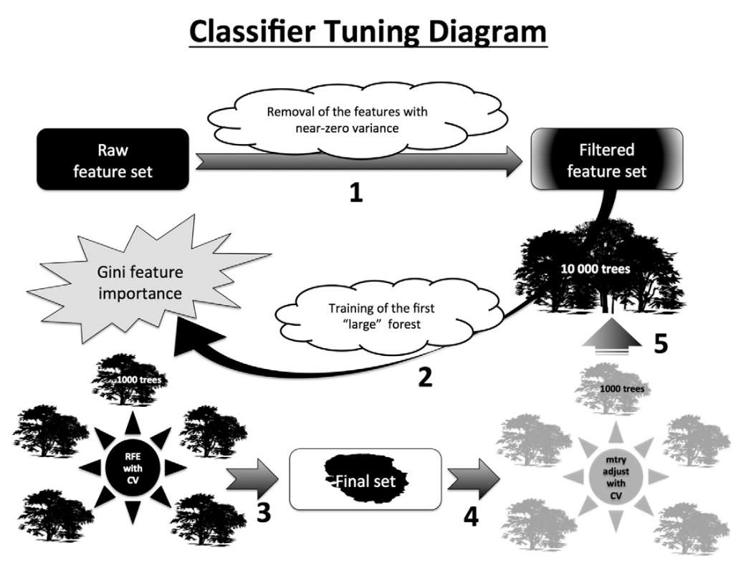
Classifier Tuning
The model must be tuned to reach better results
Done through Recursive Feature Elimination (RFE)
Remove near-zero variance features
Find the optimal m_try value with CV.
Find the Global Gini Importance of all features and keep the n first ones.
Early stopping criteria
https://doi.org/10.1016/j.nicl.2014.08.023

Slide 16
Parallelization

Slide 17
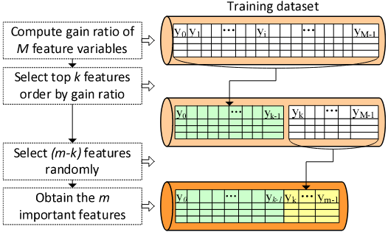
Parallelization
A method that allows the model to be trained and set up concurrently and in parallel
The training data set is reduced to only the “important features” by Gain ratio.
http://dx.doi.org/10.1093/bioinformatics/bti721

Slide 18
Parallelization
Weighted Voting: Provides the model with more accuracy, since it prioritizes the more accurate trees.
It applies OOB-Error to get the weight of each tree.

Slide 19
Parallelization
There are two main and necessary parts of parallelization:
Data Parallelization
Vertical data partitioning
Data multiplexing
Task Parallelization
Training parallelization
Task scheduling

Slide 20
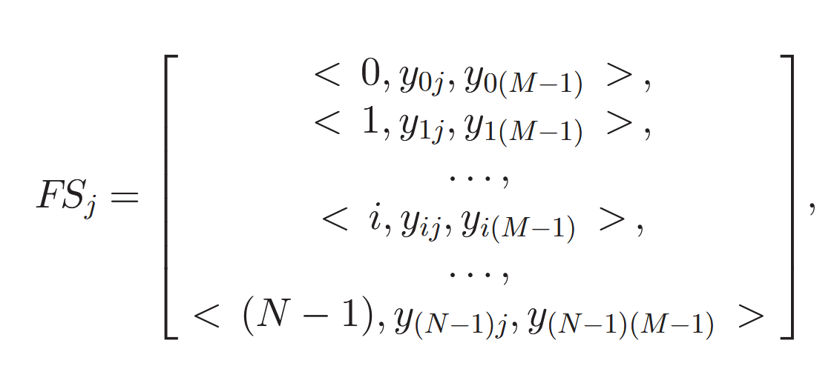
Data Parallelization: Vertical data partitioning
For each feature, a feature set (FS_{j}) is created.
It contains the index, the feature value, and the target feature value.
This is later transformed into a Resilient Distributed Dataset (RDD) object for the tasks to use.
To minimize access the volume of the gain ratio computation input data.
http://dx.doi.org/10.1109/TPDS.2016.2603511

Slide 21
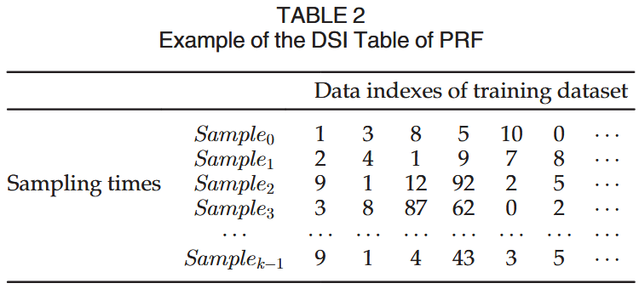
Data Parallelization: Data multiplexing
Copying for the FS every time causes a lot of overhead and space.
Introduce Data Sampling Index (DSI) tables for each slave node.
DSI table saves the indexes every sampling time.
Each gain ratio task is fed the record of the index in the DSI that it needs
http://dx.doi.org/10.1109/TPDS.2016.2603511

Slide 22
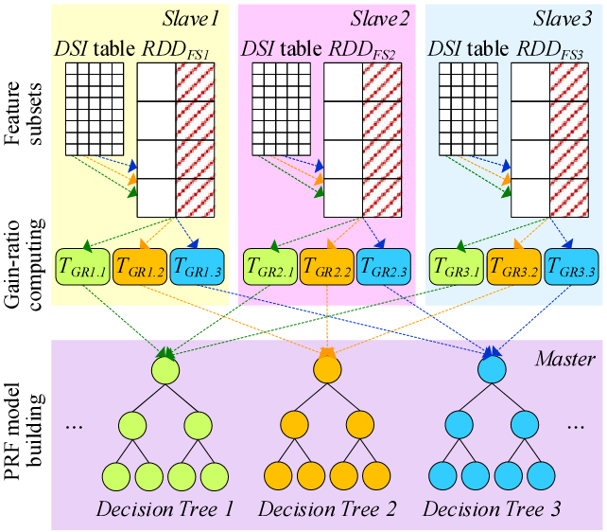
This is what the data multiplexing diagram would look like, including the tasks.
http://dx.doi.org/10.1109/TPDS.2016.2603511

Slide 23
Parallelization
There are two main and necessary parts of parallelization:
Data Parallelization
Vertical data partitioning
Data multiplexing
Task Parallelization
Training parallelization
Task scheduling

Slide 24
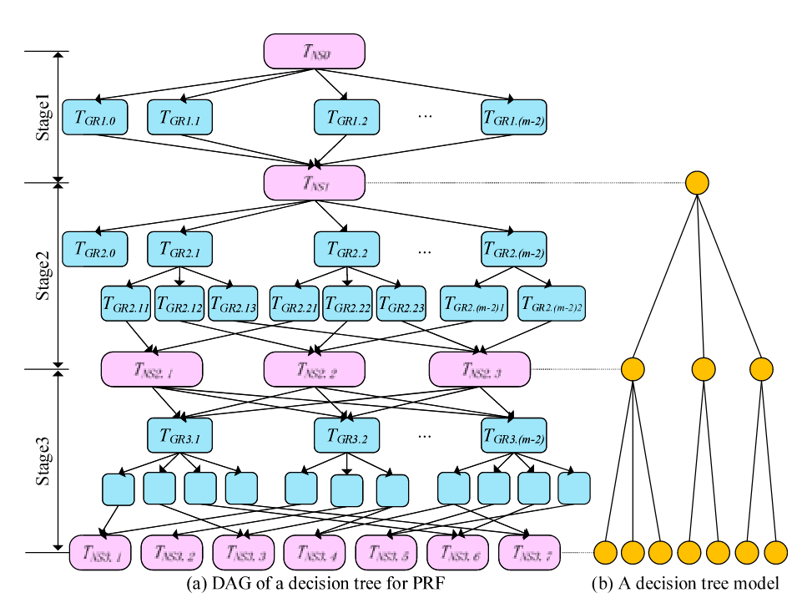
Task Parallelization: Training Parallelization
This Graph (Directed Acyclic) represents the flow of tasks
In blue: Gain ratio tasks. In pink: Node splitting.
All tasks situated in the same level are executed in parallel.
The number of GR tasks in between is dependent on the feature records (distinct values, number of intervals, …).
This graph is created for each decision tree.
http://dx.doi.org/10.1109/TPDS.2016.2603511

Slide 25
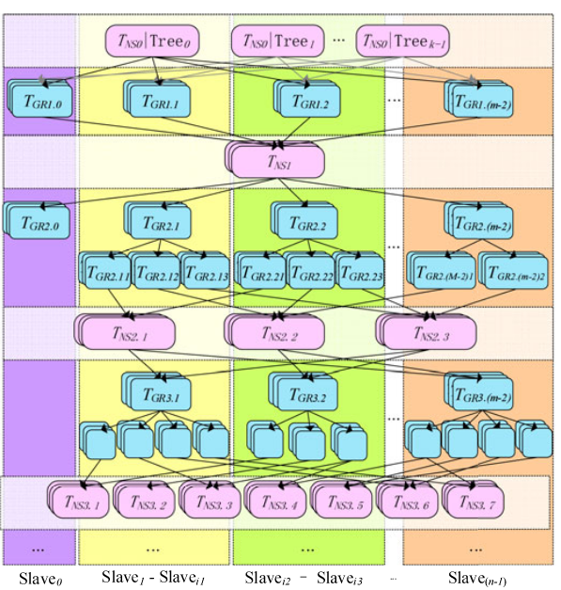
Task Parallelization: Task Scheduling
T_{GR} can use a local scheduler thread pool (SPARK), where the threads are ready to be assigned, and can communicate.
T_{NS} must use a cluster scheduler, that controls the flow of the nodes, for the synchronization.
http://dx.doi.org/10.1109/TPDS.2016.2603511
http://dx.doi.org/10.1109/TPDS.2016.2603511

Slide 26
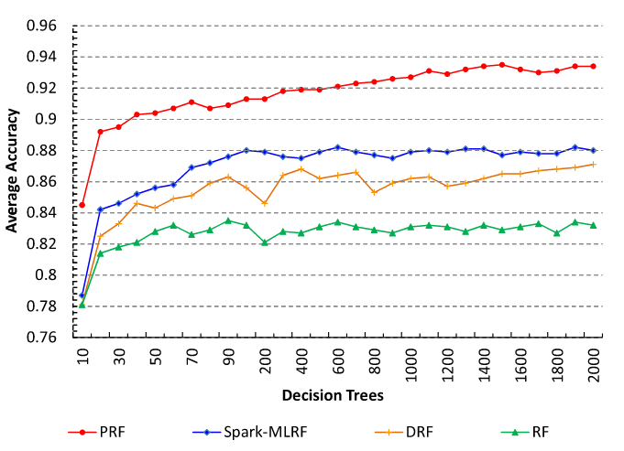
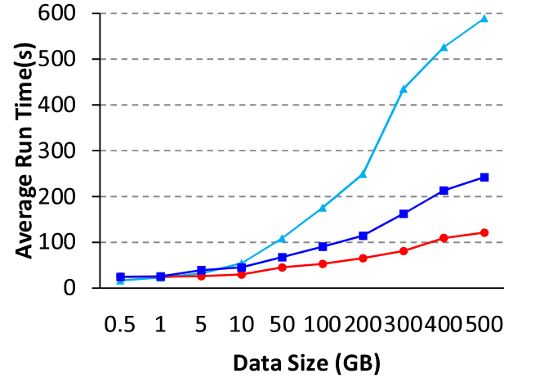

PRF vs RF
http://dx.doi.org/10.1109/TPDS.2016.2603511
http://dx.doi.org/10.1109/TPDS.2016.2603511

Slide 27
Conclusion
This presentation went over:
Theoretical explanations of RF
Fields of use
Possible optimizations
Parallelism

Slide 28
Thank you for your attention!

